Slide 1
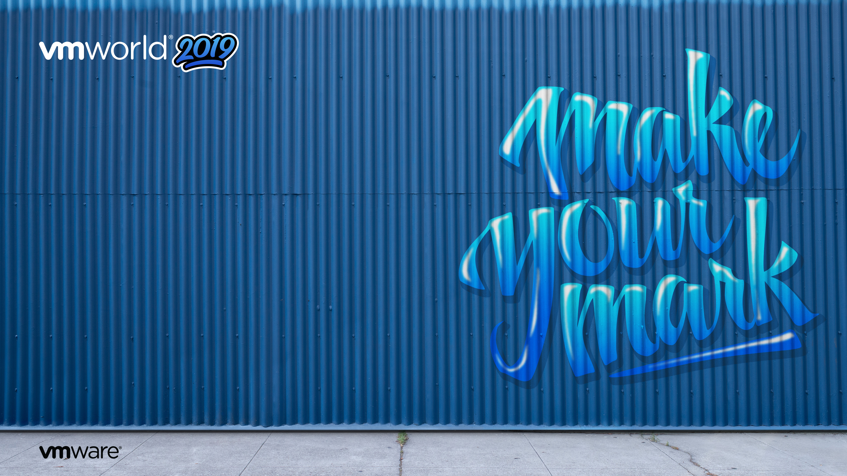
Transforming your Enterprise Architecture with Rubrik and VMware
HBI3519BES
Mike Preston : Developer Advocate @ Rubrik
Daniel Alfredsson: Technology Evangelist @ Trygg-Hansa
#vmworld #HBI3519BES

Slide 2



Mike Preston
Daniel Alfredsson
Tweets
Codes
Works
Does
Likes
Works
Does
Likes
Technology Evangelist @ Trygg-Hansa
Lead-architect, Coding, Talking
Cloud Tech, Tennis and Golf
mwpreston
mwpreston
Developer Advocate @ Rubrik
Coding, Writing, Talking
Hockey and Maple Syrup

Slide 3
Agenda
Trygg-Hansa’s Digital Journey
How can Rubrik help?
Demos – The Live Kind
Wrap-up

Slide 4
Trygg-Hansa’s Digital Journey

Slide 5


Trygg-Hansa
Leading Swedish insurance company since 1828
80 000 lifeboys deployed. Saves 14 lifes per year.
Part of RSA Group.
Operations: UK, IE, CAN, Scandinavia, Middle-east
Target: Leading digital insurance company
Engineers/Software developers: ~350 people

Slide 6
Technology agenda
Trygg-Hansa digital journey
Recruitment of ~100 talented engineers
Establish a Hybrid Cloud platform
VMware Cloud Foundation and Rubrik
Publish a fully automated Cloud Service Catalog
Establish a Cloud Native platform and tool-set (CI/CD)
Re-platform and Re-engineering of business system landscape.
Tech focus areas: Data Analytics, AI/ML, Robotics, IoT/5G

Slide 7

Hybrid Cloud transformation journey
Virtualization
Mainframe
TEST/DEV
Mainframe applications
Existing DC
QA/PROD
vBlock
IT Service catalog/portal
Unified communication
Propel
Skyportal
Cloud Services
Dev Workstations
Physical Midrange
TEST/DEV
QA/PROD
Physical Wireless Controller
Desktop Virtualization
Physical Firewall
Citrix
Physical Proxy
Physical VPN
Branch office(s)
SD-WAN connected
Physical DNS
Physical Wireless Controller
Private Cloud - SDDC
Network Virtualization
Workloads
Mainframe emulation Platform
Workplace virtualization
Dev workstations
Container platform
Internet Connectivity
Virtual Firewall
Virtual Proxy
SD-WAN
TEST/DEV
Modern applications
(Cloud Native)
Mainframe applications
Digital Workplace
Dev Workstations
MPLS Connectivity
Virtual DNS
Virtual Wifi
Virtual VPN
QA/PROD
Data Center 1 (co-lo)
Data Center 2 (co-lo)
Vmware Cloud on AWS/Azure
Internet Connectivity
MPLS Connectivity
Cloud Services
Unified communication

Slide 8
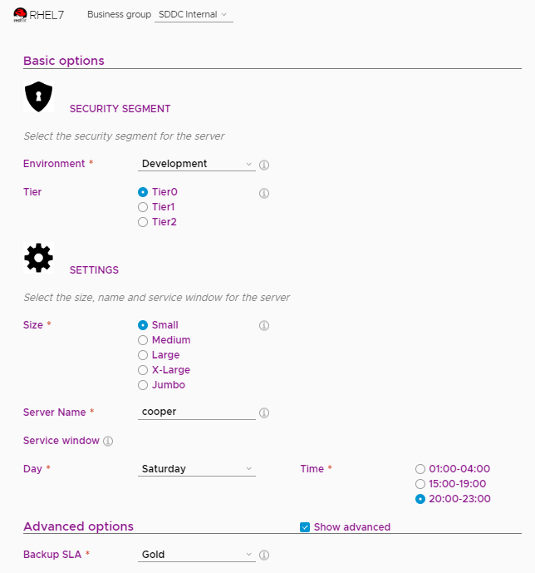
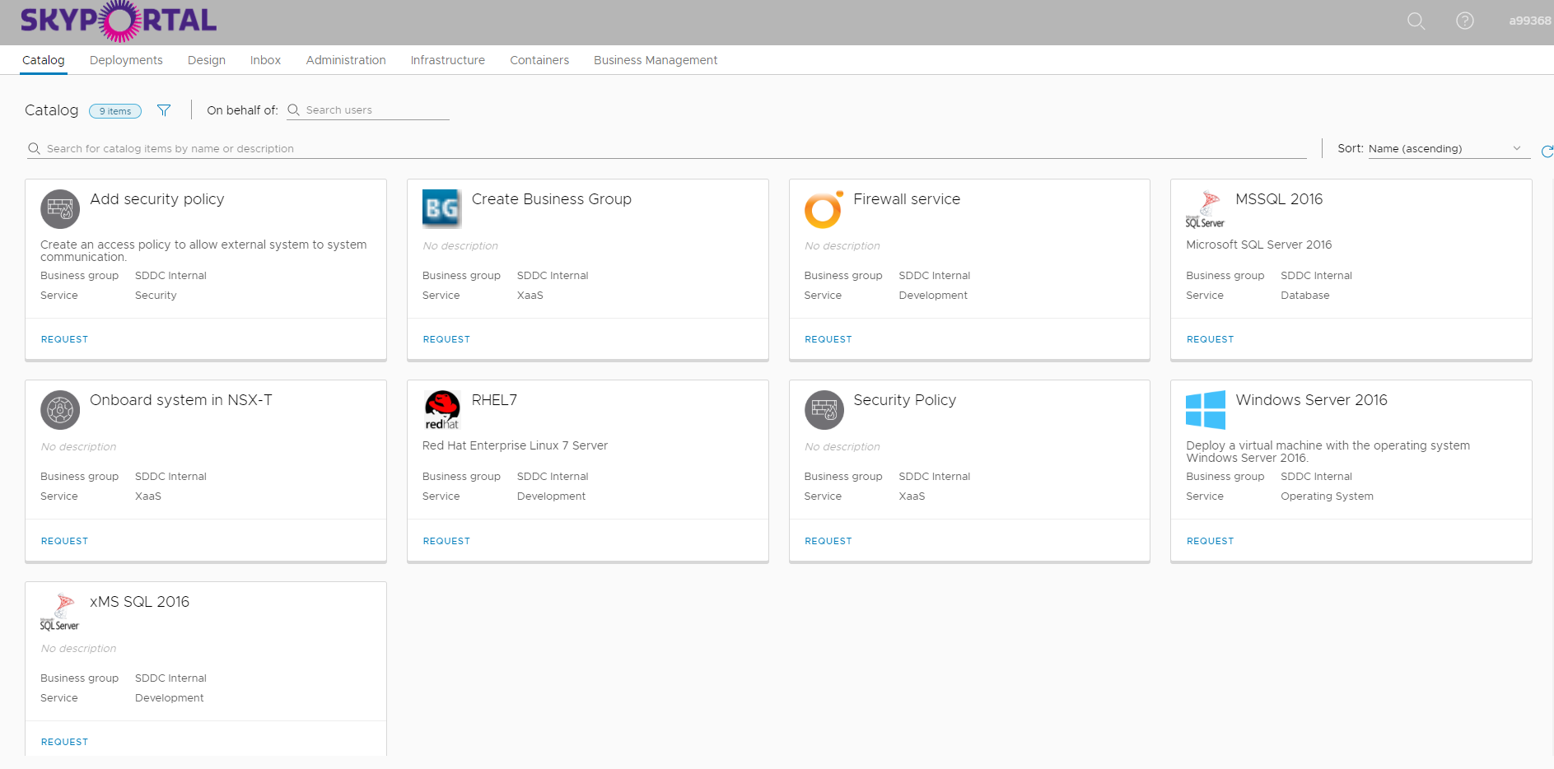


The Cloud Self-Services
Skyportal
API integration with Rubrik
- SLA policy -
- Restore options -
vRealize Automation

Slide 9
How does Rubrik fit in?

Slide 10

How does Rubrik fit into Trygg-Hansa’s journey?
Applying declarative polices to infrastructure projects
Integration with new and existing automation toolsets
Self-Service Portal providing a user and application centric focus

Slide 11
Applying declarative policies to infrastructure projects

Slide 12

What do we mean by declarative?

Slide 13



Data Protection – Current State Reality
Job
Job
Job
Job
Job
Job
Job
Job

Slide 14

Data Protection with Rubrik
SLA
SLA
SLA
SLA

Slide 15
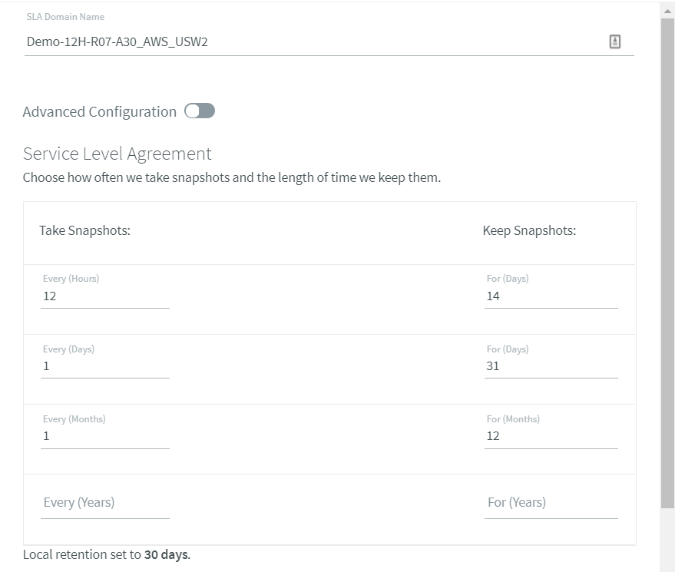
SLA Domain Details – RPO & Retention
The RPO & Retention values, measured in time, to uphold.
How often to backup? How long to keep data?
Policies applied to any type of workload across any locality.

Slide 16
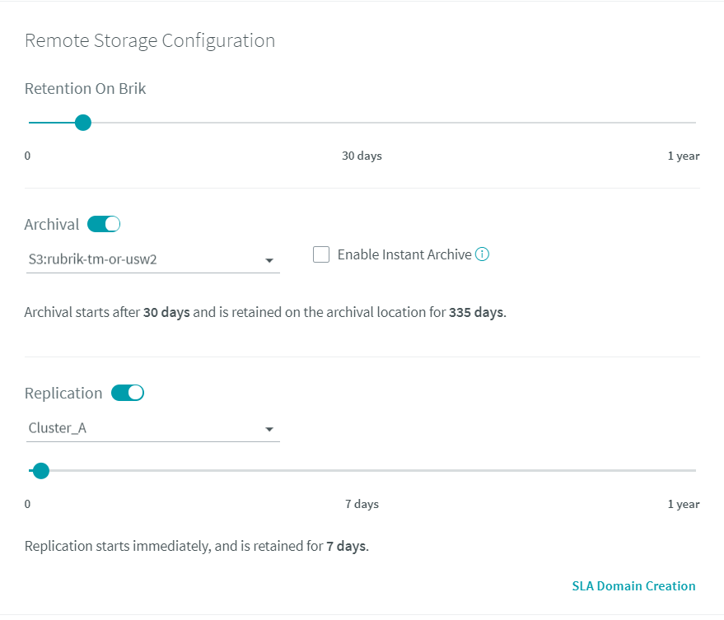
SLA Domain Details – Archival & Replication
The RTO value, measured in time and expressed as local retention.
Long term retention (archive) in your desired storage target (object, cloud, file, tape, etc.)
Replication target for Disaster Recovery.

Slide 17
Integration with new and existing automation toolsets

Slide 18


Just use the APIs – It’s easy right?
Just figure out the hidden parameters, form the JSON body, craft some token based authentication, set the content-type, build the request headers, guess the associated HTTP method, construct the URI, send the request and parse the massive response we send back for what you need!
Oh you are trying to do that – we don’t have an API for that yet

Slide 19


Taking a Different Approach with APIs
Full-featured APIs
User-friendly Resources
Pre-built Integrations
Built API-first
All functionality is exposed.
Get started immediately
Easy to access and learn.
Integrate with your existing tools
Easy to consume & integrate

Slide 20


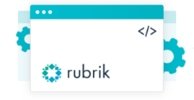
Data Protection Integration Points
IT Service Catalogs
Configuration Management
vRealize Automation
Automation Tools
Cloud Management

Slide 21
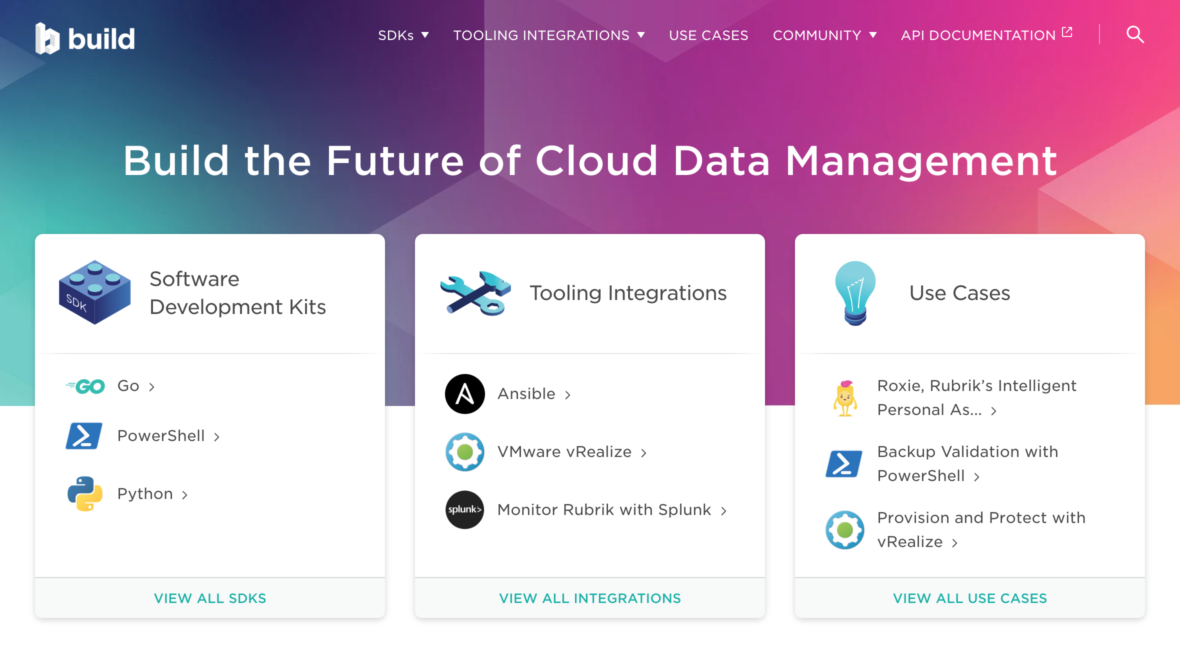
© 2019 Rubrik. All rights reserved.

Slide 22
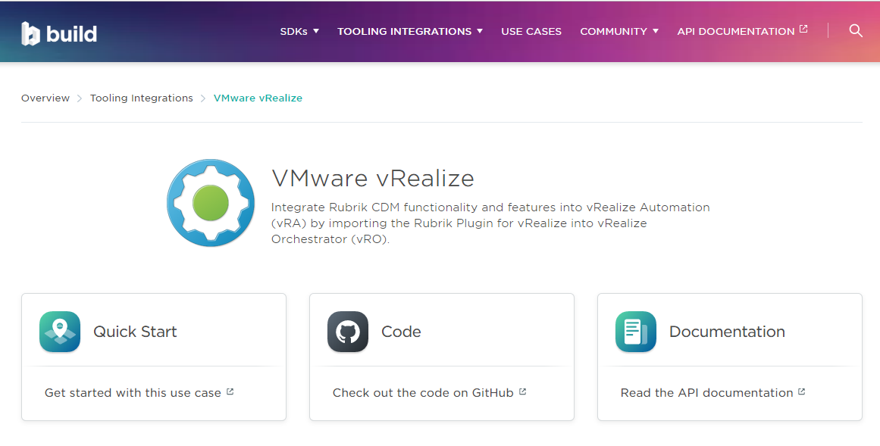
© 2019 Rubrik. All rights reserved.

Slide 23
Self-Service portal providing a user and application centric focus

Slide 24



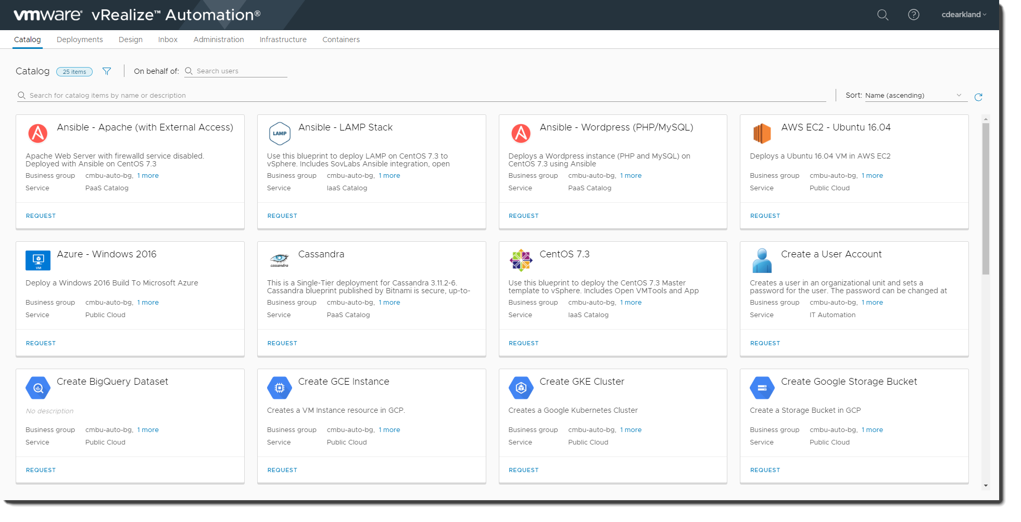

Self-Service Portal with vRealize Automation
Providing a user and application centric focus
Self-Service Provisioning
Lifecycle Management
Cloud Orchestration

Slide 25

Integration with vRealize Automation
Eliminate lengthy wait times and ticket overflow at your service desk by enabling self-service data management
Self-Service Provisioning
Lifecycle Management
Cloud Orchestration
Data Management
App
Remove siloes by managing data protection from vRA along with the rest of your operations
Leverage a pre-built integration with vRA to help you get started easily
Enable self-service SLA protection, file recovery, and multitenancy

Slide 26
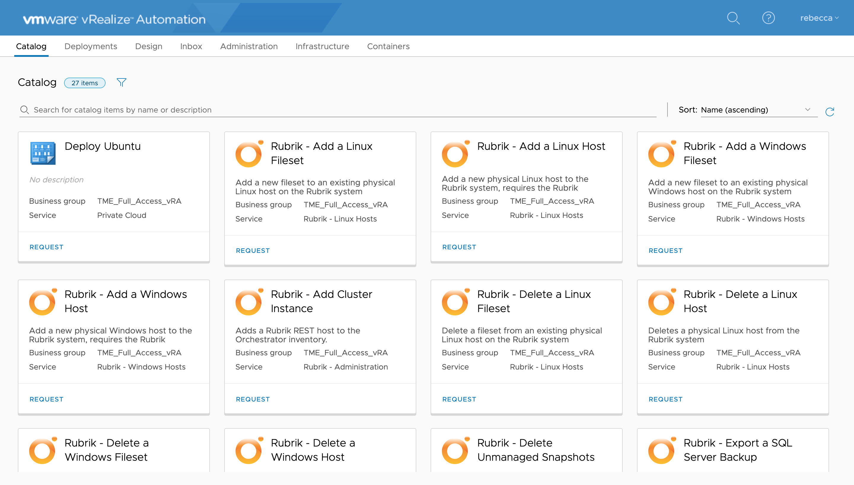
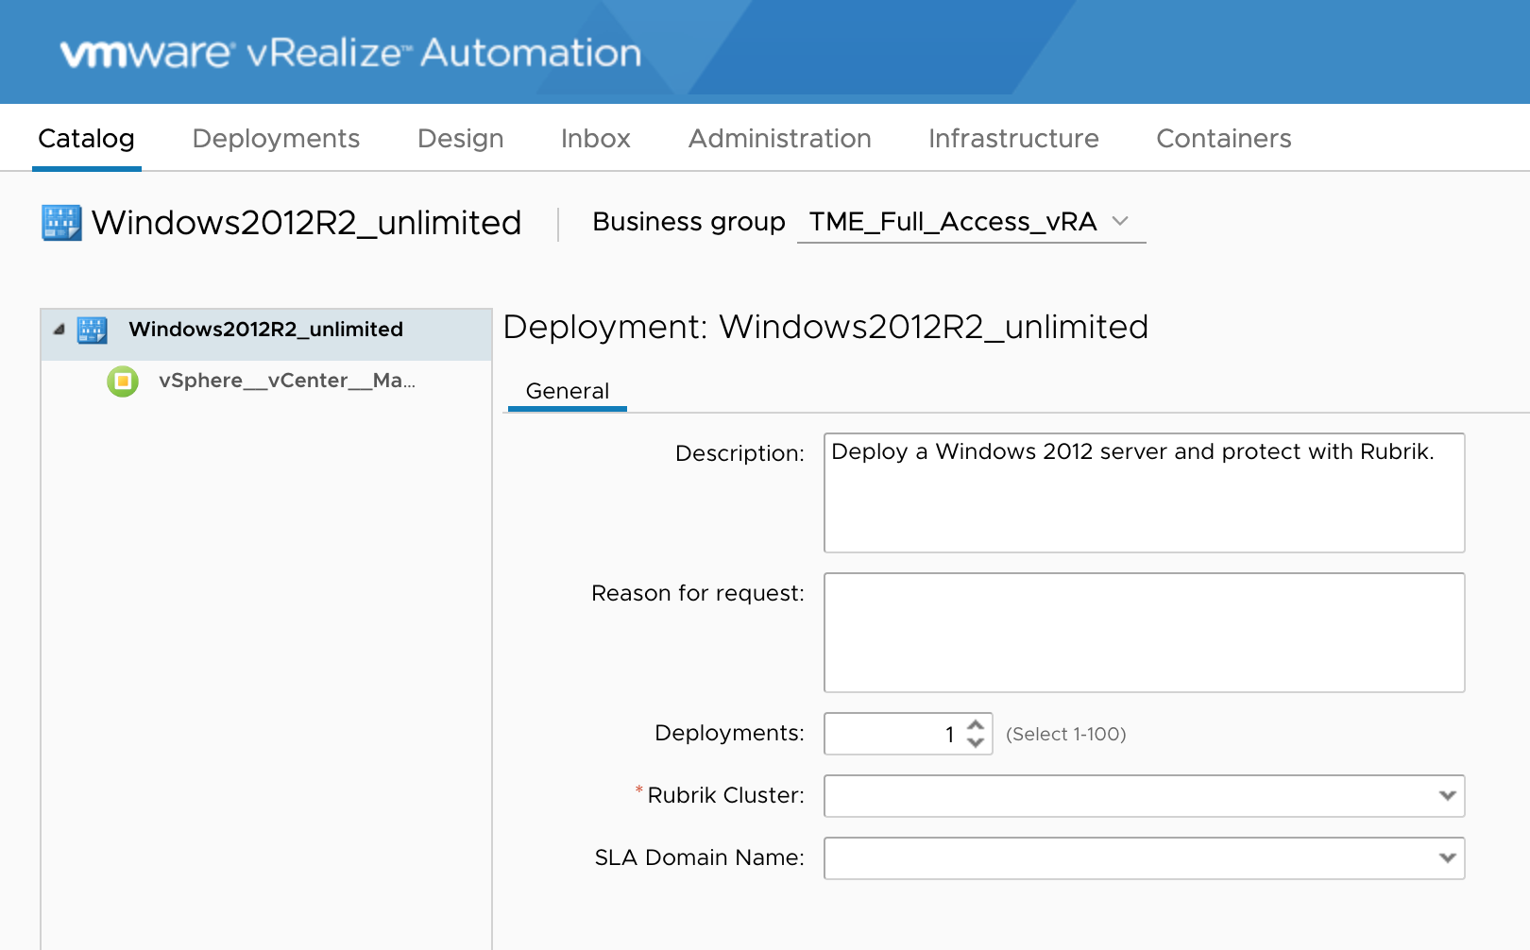


Rubrik Plugin for vRealize
Provision and protect new workloads with vRA, consume Rubrik functionality through your service catalog
Example Functionality:
Take on-demand snapshot
Recover files or folders
Manage filesets
Change SLA
Recover VMs with Live Mount
Manage organizations
User requests new app
Rubrik auto-discovers new workload and applies SLA
Rubrik REST API
vRA
VADP
VM
VM
vCenter Server
Hypervisor
vCenter SDK
Rubrik vRO workflow package

Slide 27

Rubrik Plugin for vRealize
Provide multitenancy by mapping business groups to Rubrik organizations
Tenant A
Mapping vRA to Rubrik
vRA Business Groups map to Rubrik Organizations
Business Groups limit catalog item access, Rubrik Organizations limit what objects are available to catalog items
Example: DBA Business Groups/Orgs to restrict access to only database related activities and objects
Business Group
Business Group
Organization A
Organization B
Tenant B
Organization C
Organization D
Business Group
Business Group

Slide 28
vRA Demo

Slide 29
Integrated management to provide efficiencies and scale

Slide 30
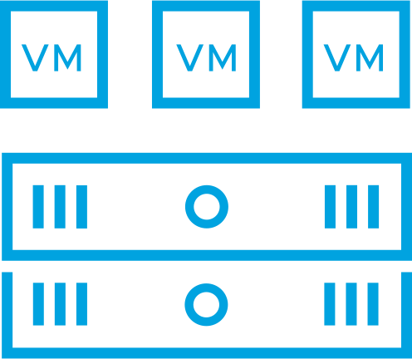
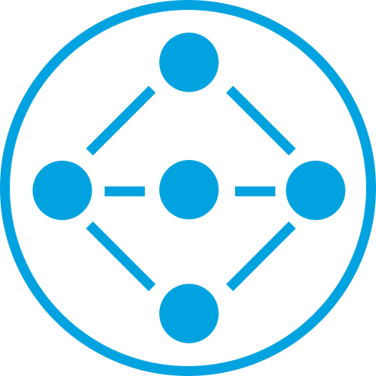
Holistic Protection for Management and Workload Domains
Apply protection policies across your entire Cloud Foundation infrastructure
SDDC Manager
vCenter Server
NSX
vRealize Log Insight
Management Domain
Compute
Network
Storage
Workload Domain(s)

Slide 31
Benefits of Rubrik and VMware Cloud Foundation
Use Rubrik to easily and quickly protect and restore Cloud Foundation
Easy to Use
Faster Recovery
Fully Automatable
Declarative system that minimizes daily management.
Use Live Mount or Instant Recovery to recover workloads.
Automate service delivery with full-featured APIs.

Slide 32

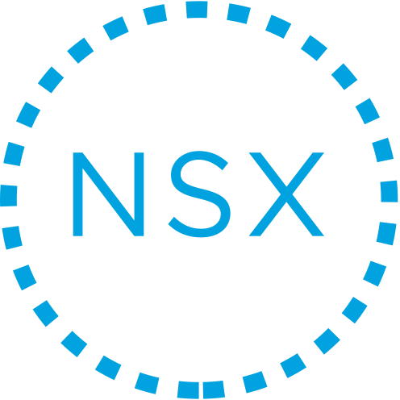

Use Rubrik to Protect Management Domain
Ensure recovery of Management Domain components
Cloud Foundation Management Domain
Apply an SLA Domain to protect your critical management components:
SDDC Manager
It is recommended to export SDDC configurations as part of your protection strategy
vCenter Server
NSX Manager
Protected by SDDC Manager, which is in turn protected by Rubrik
vRealize Log Insight
SDDC Manager
vCenter Server
NSX Manager
vRealize Log Insight
vSphere Distributed Switch
ESXi01
ESXi02
ESXi03
ESXi04
vSAN Datastore

Slide 33
Management Domain Recovery
Use Rubrik to recover Management Domain components in the event of failure
Recover or re-build ESXi hosts
Cloud Foundation Management Domain
Recreate vSAN datastore
Restore SDDC Manager
SDDC Manager
vCenter Server
NSX Manager
vRealize Log Insight
Restore vCenter Server using image-level backup, or deploy new and restore file-based backup
vSphere Distributed Switch
Restore vRealize Log Insight, master node first, then worker node(s)
ESXi01
ESXi02
ESXi03
ESXi04
vSAN Datastore
Redeploy NSX Manager and perform file-based restore
Run health check on SDDC Manager

Slide 34
Learn More!
documentInventory.sh
https://github.com/mwpreston/VCF
Reference Architecture – Rubrik & VCF
http://bit.ly/rubrik-vcf

Slide 35
Wrap up

Slide 36
Trygg-Hansa Benefits with Rubrik
Remove data protection as a roadblock
Simplify the lifecycle management process
Integration with automation toolsets
Provide robust recovery options for infrastructure services
Provide a highly automated environment focusing on users and applications
More available FTE time to work on strategic projects and paying down technical debt.

Slide 37

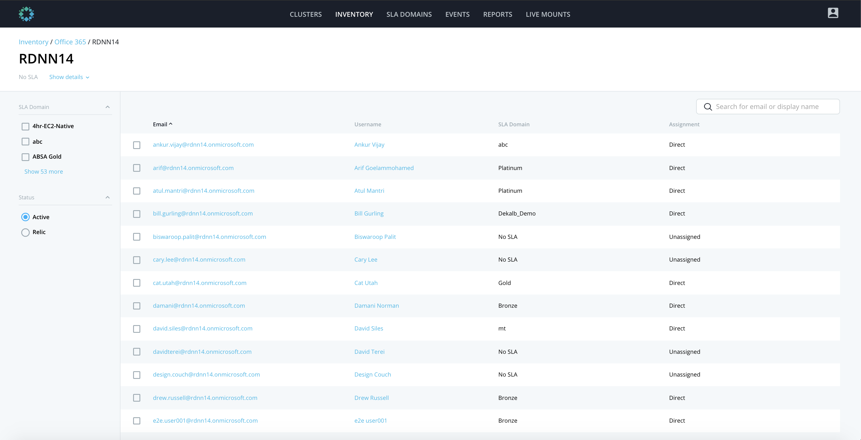
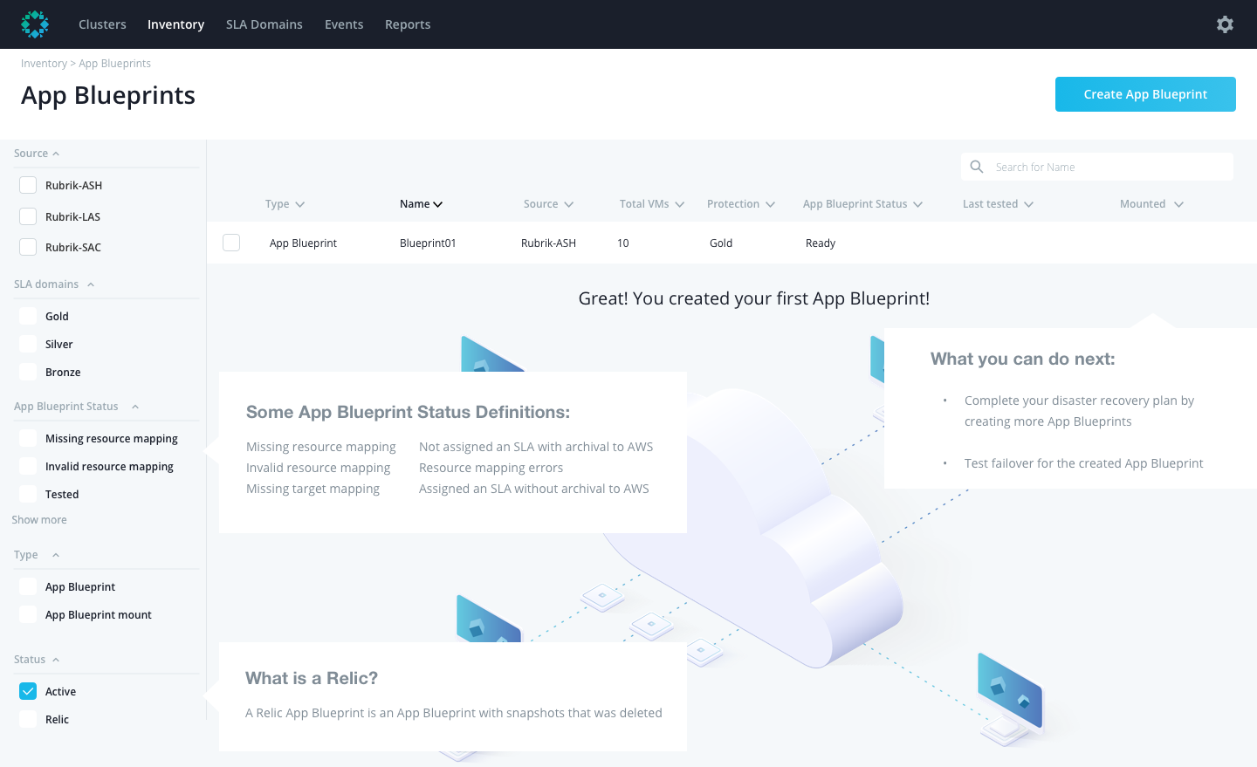
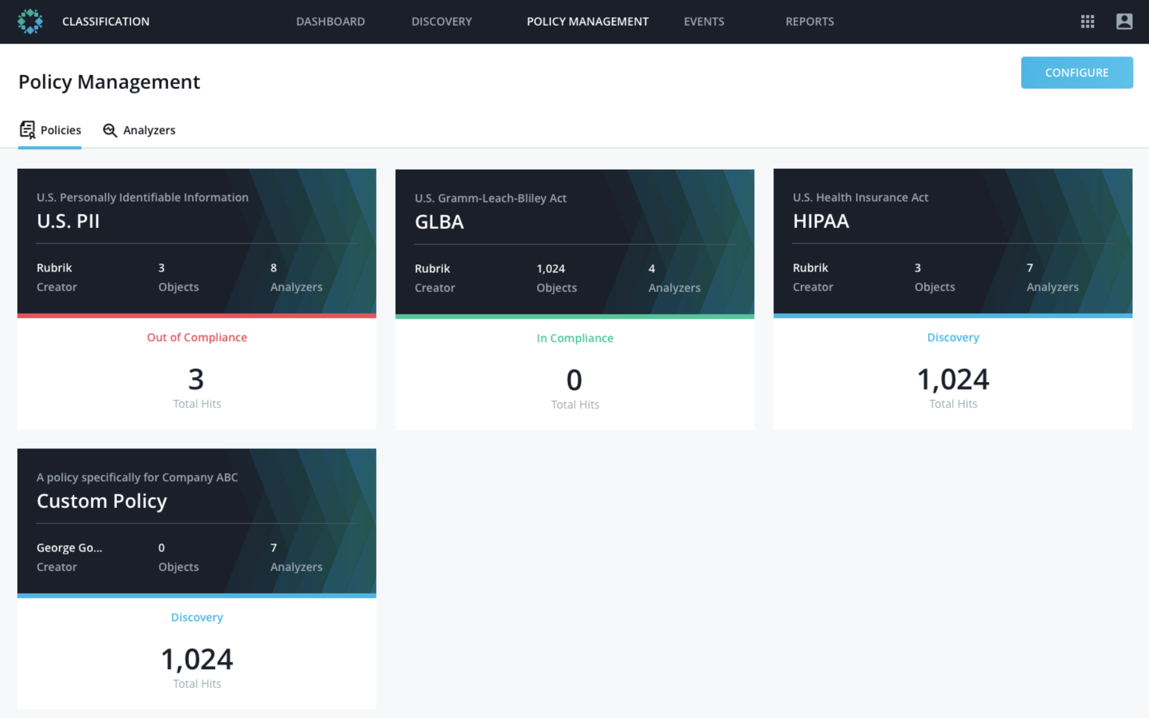
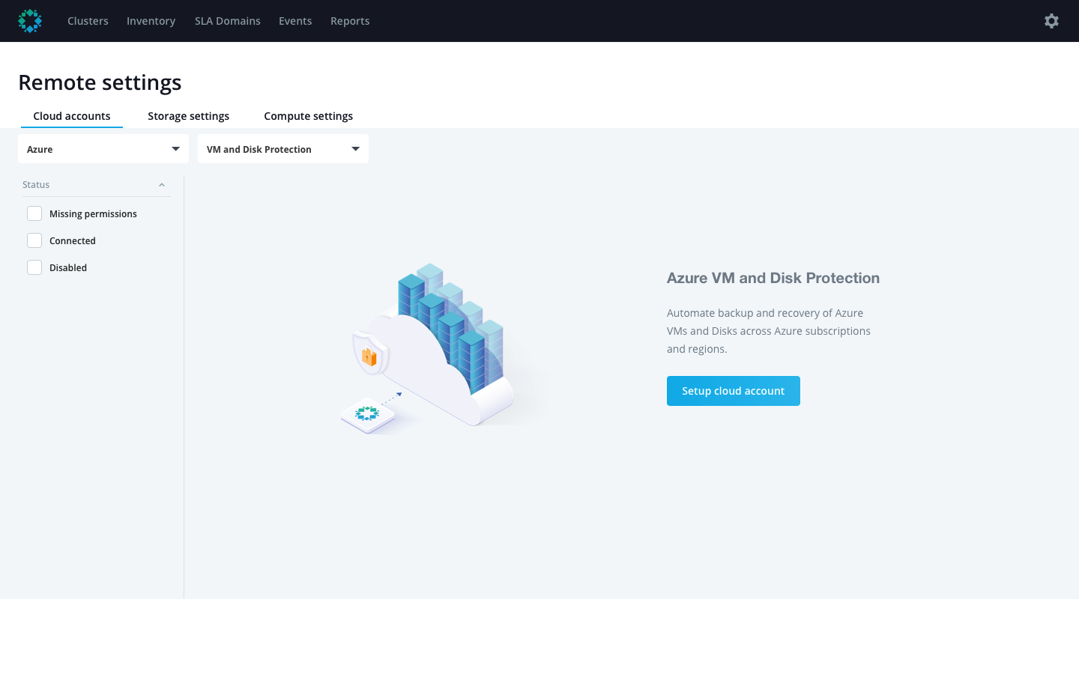
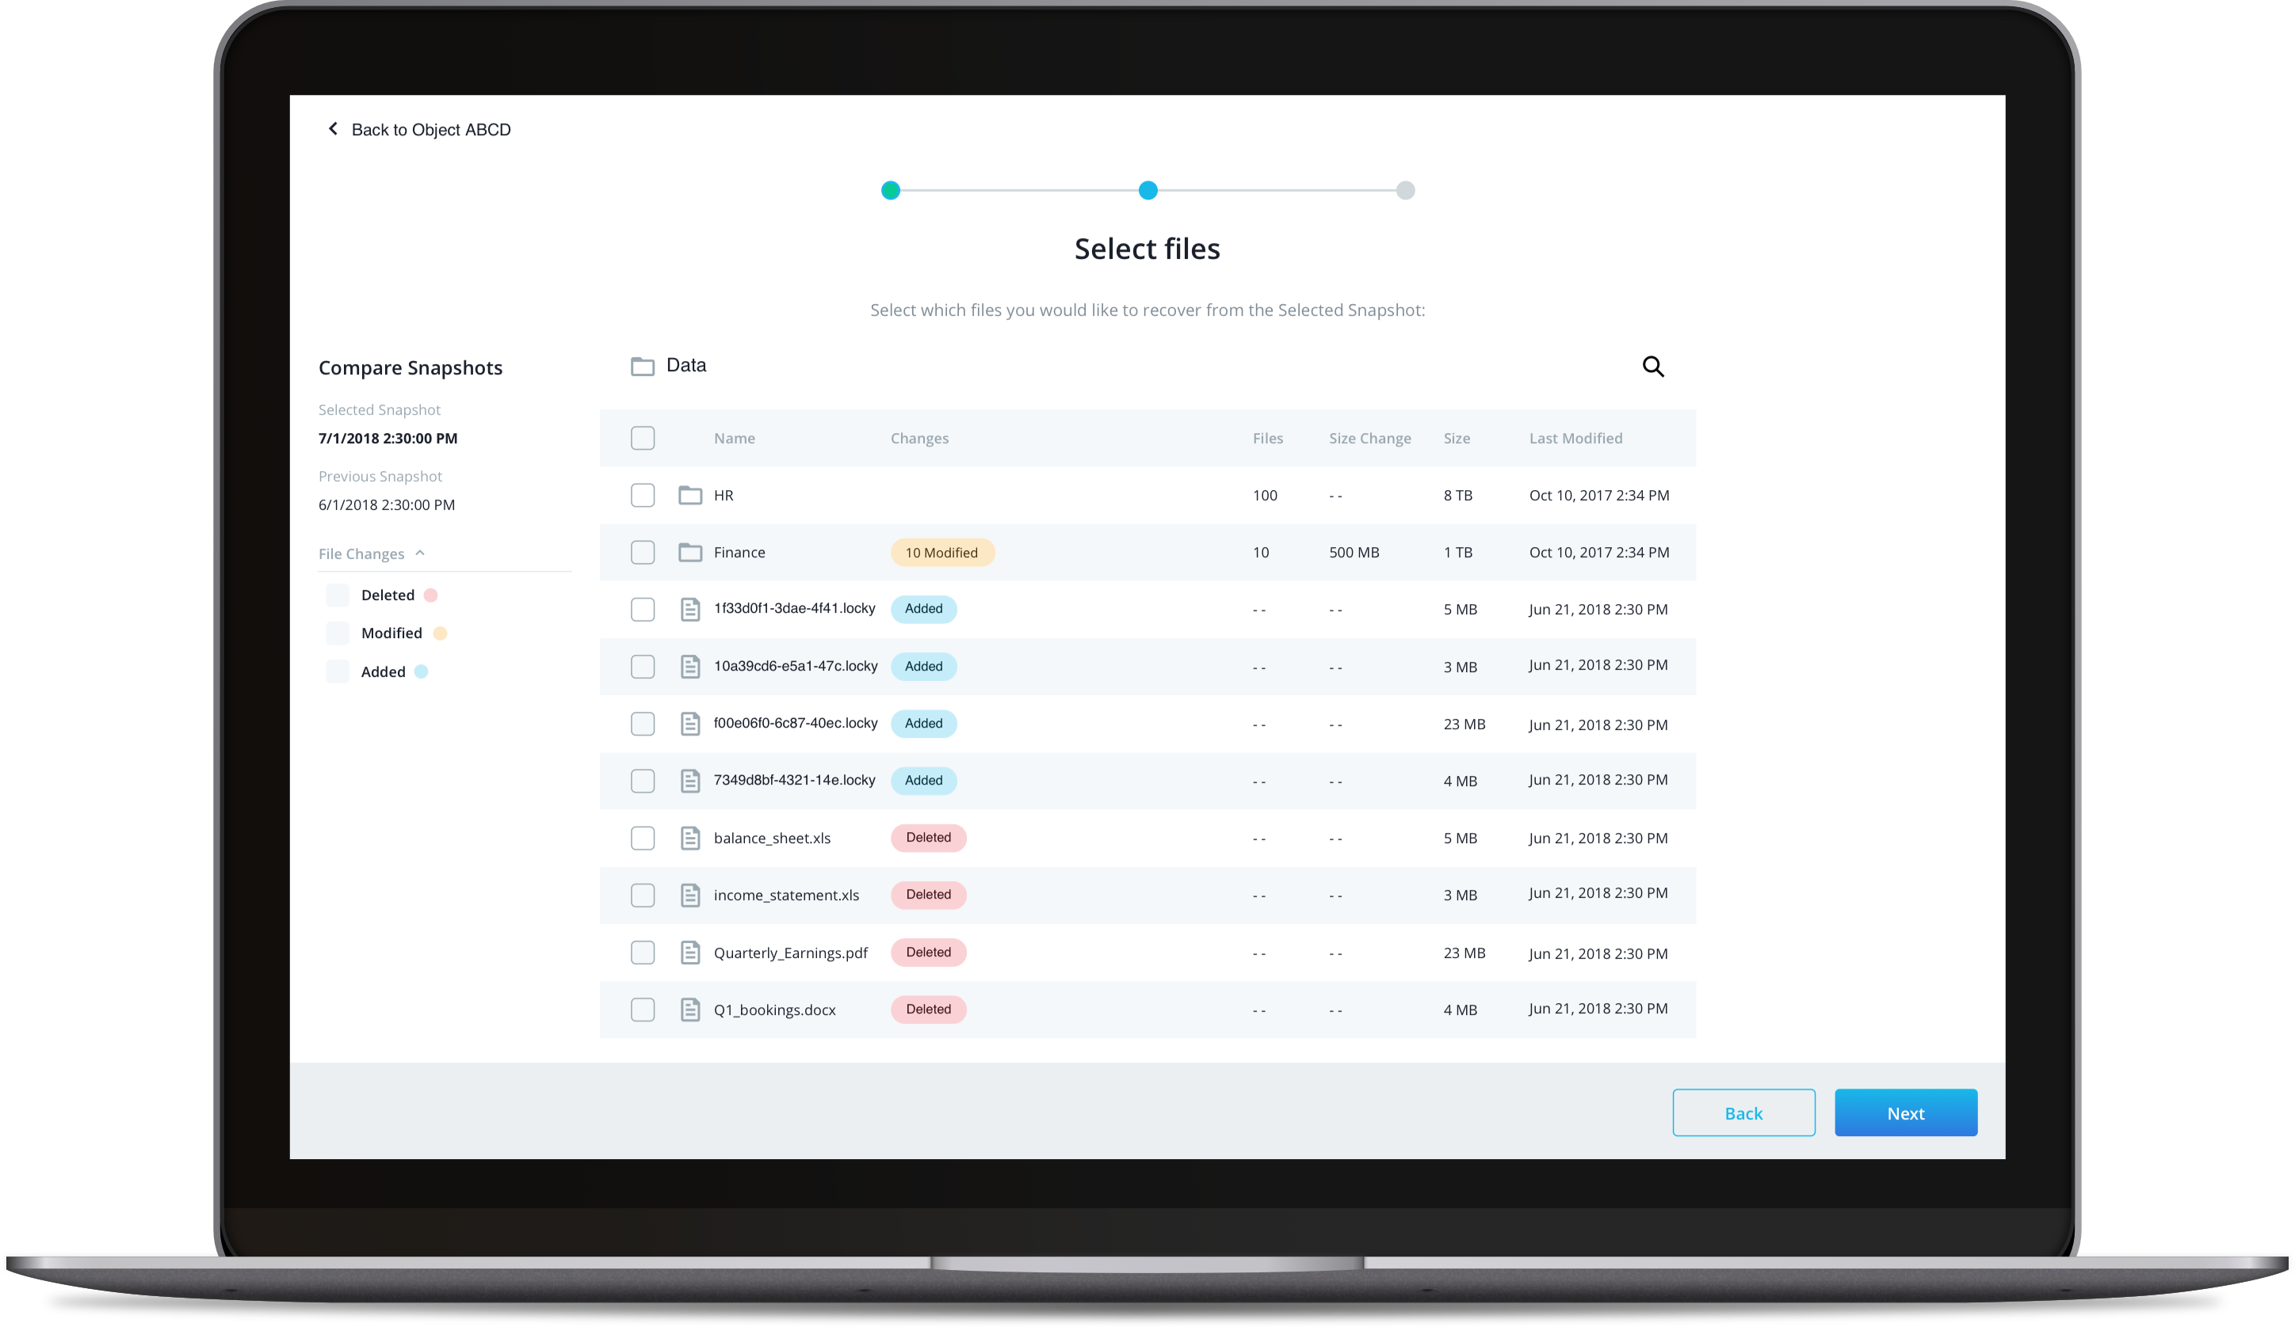
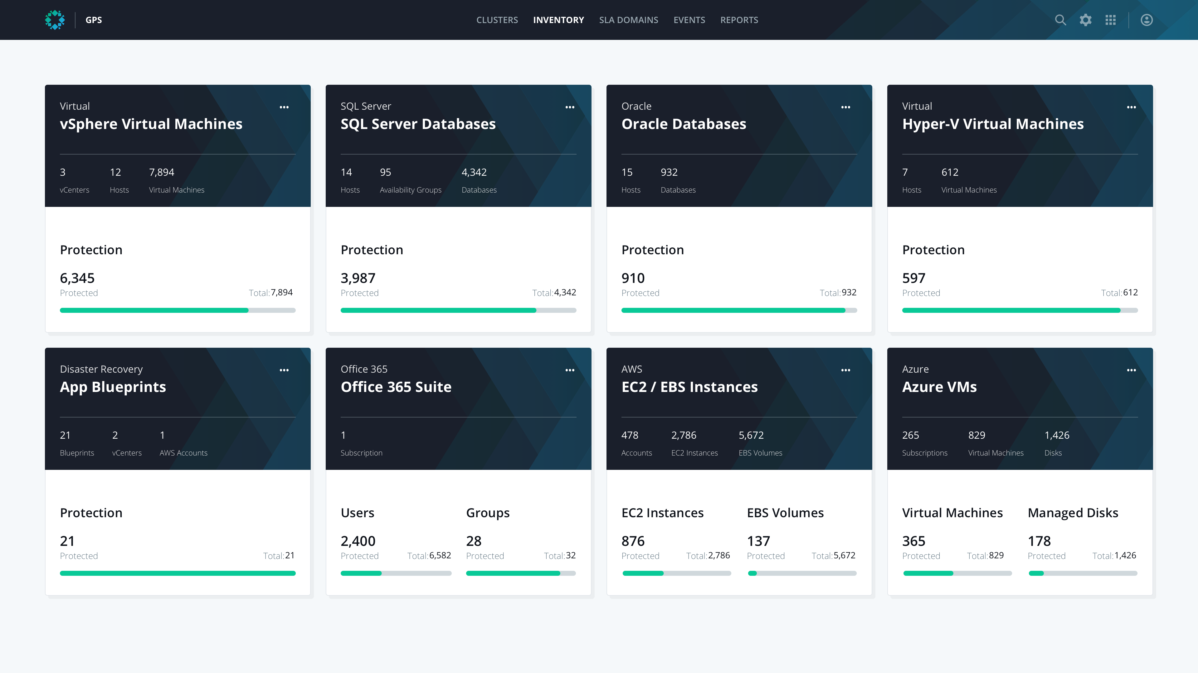
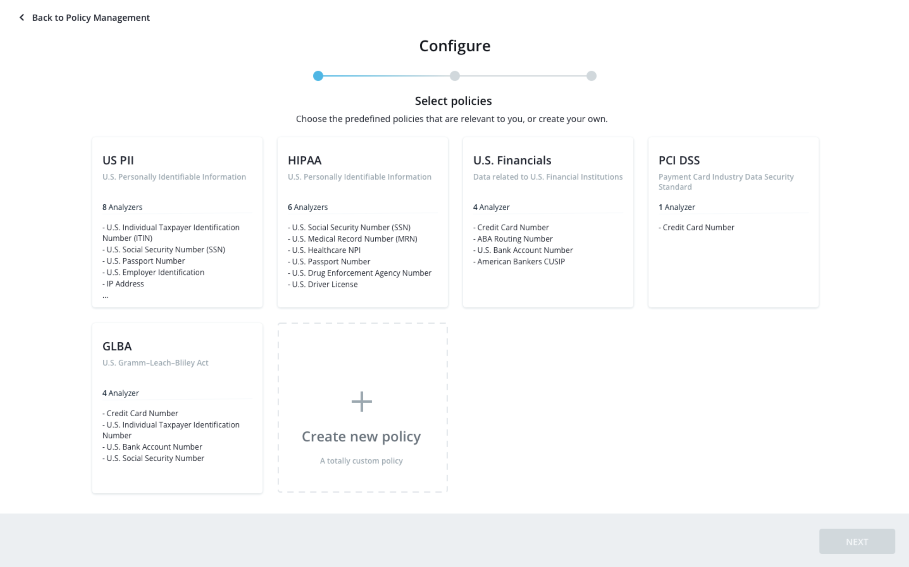


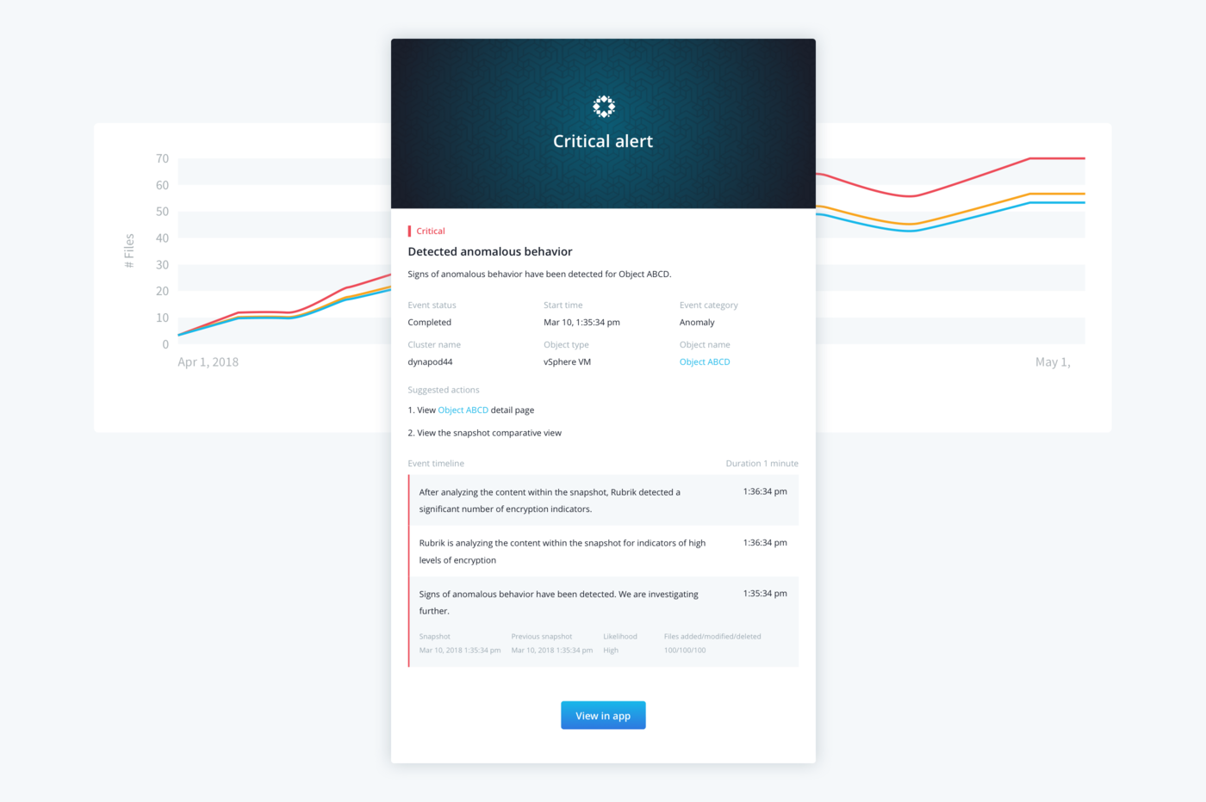










Data Protection Does More
Cloud App Protection
GPS
Radar
O365
AppFlows
Sonar
Polaris SaaS
VM
VM
NAS
Polaris GPS
Global Data Policy & Management
Across Enterprise Applications and Clouds
Polaris Radar
Automated Ransomware Detection & Remediation Impact Assessment & 1-Click Recoveries
Polaris O365 Protection
Cloud-Native Protection Scales In-line with O365 Environment
Protected Data Never Leaves Customer’s Azure Subscription
Polaris Cloud App Protection Unified Management of Large-scale AWS & Azure Environments Automate via Tag-based SLA Protection
Polaris AppFlows DR Orchestration for Failover/Failback, Testing, Migration
Provide Minute-level RTOs and Automate Cloud Instantiation
Polaris Sonar
Data Classification to Comply with Data Privacy Regulations
Zero Additional Infrastructure – Get Started Immediately

Slide 38
Rubrik’s Focus
Reduce Complexity
Increase Capabilities

